Slide 1
Kafka Spring

Slide 2
Kafka & Spring
Kafka ships with low-level Kafka consumers and producers optimized for the control plane protocol that Kafka
components use. Spring provides Kafka abstractions classes on top of the low-level API. This allows you to
integrate with Kafka in a ‘Spring’ like fashion using CDI, annotations and an opinionated config approach.
A few perquisites must be in place before Kafka can be used in Spring.
The following dependency must be in place if you run maven:
In the application.properties you can specify some default consumer and producer properties.
Often you just need to specify a (comma-separated list) of brokers:
<dependency>
<groupId>org.springframework.kafka</groupId>
<artifactId>spring-kafka</artifactId>
</dependency>
spring.kafka.consumer.bootstrap-servers=localhost:29092
spring.kafka.consumer.group-id=demo-group
spring.kafka.consumer.auto-offset-reset=earliest

Slide 3
Exercise
Introduce spring project structure
Copy + rename from template kafka-demo project
Open IntelliJ and import projects
How to run programs
Solutions folder
7.1

Slide 4


Kafka low-level style
Kafka low-level style
Kafka Spring style
Kafka admin client
Testing Kafka

Slide 5
Low-level producer
// Define properties used by the consumer
Map<String, Object> props = new HashMap<>();
props.put(ProducerConfig.BOOTSTRAP_SERVERS_CONFIG, bootstrapServer);
props.put(ProducerConfig.KEY_SERIALIZER_CLASS_CONFIG, StringSerializer.class);
props.put(ProducerConfig.VALUE_SERIALIZER_CLASS_CONFIG, StringSerializer.class);
try (KafkaProducer<String, String> producer = new KafkaProducer<>(props)) {
// Create a ProducerRecord – with the possibility to also specify partition
ProducerRecord<String, String> producerRecord = ProducerRecord<>(”demo-topic", ”Hello world");
// Send and flush the buffer
producer.send(producerRecord);
producer.flush();
}

Slide 6
Exercise
Create vanilla java producer
Create a new topic and assign 2 partitions
Write a java producer that produces a single message to the above kafka topic
Create a console consumer that listens to the above topic. Use --from-beginning --property print.partition=true --property print.offset=true
Verify that the message is consumed.
Change to producer to write to partition 0 only (use ProducerRecord constructor)
Verify that the messages get consumed in the console consumer and that the partitions are all from partition 0
7.2

Slide 7
Low-level consumer
// Define properties used by the consumer
Map<String, Object> props = new HashMap<>();
props.put(ConsumerConfig.BOOTSTRAP_SERVERS_CONFIG, bootstrapServer);
props.put(ConsumerConfig.KEY_DESERIALIZER_CLASS_CONFIG, StringDeserializer.class);
props.put(ConsumerConfig.VALUE_DESERIALIZER_CLASS_CONFIG, StringDeserializer.class);
props.put(ConsumerConfig.GROUP_ID_CONFIG, groupId); // Consumer group
try (KafkaConsumer<String, String> consumer = new KafkaConsumer<>(props)){
consumer.subscribe(Arrays.asList("topic")); // Subscribe to one or more topics
while (true) { // Endless loop with polling
ConsumerRecords<String, String> records = consumer.poll(Duration.ofMillis(100));
for (ConsumerRecord<String, String> record : records) {
… Do something
}
}
}

Slide 8
Exercise
Create vanilla java consumer
Create a new topic with 2 partitions
Write a java consumer that consumes from the above topic. Output the consumed messages
Consider using props.put(ConsumerConfig.AUTO_OFFSET_RESET_CONFIG, "earliest");
Create a consoles producer that allows you to specify key and value. Use --property parse.key=true --property key.separator=":”
Write some key/values to the topic from the console producer
Verify that the messages are consumed in the java consumer
Change the program to also output the key, topic-name, partition and offset and rerun it
7.3

Slide 9
Low-level consumer – Manual Ack
Map<String, Object> props = new HashMap<>();
props.put(ConsumerConfig.BOOTSTRAP_SERVERS_CONFIG, bootstrapServer);
props.put(ConsumerConfig.KEY_DESERIALIZER_CLASS_CONFIG, StringDeserializer.class);
props.put(ConsumerConfig.VALUE_DESERIALIZER_CLASS_CONFIG, StringDeserializer.class);
props.put(ConsumerConfig.GROUP_ID_CONFIG, groupId); // Consumer group
properties.put("enable.auto.commit", "false");
KafkaConsumer<String, String> consumer = new KafkaConsumer<>(properties);
consumer.subscribe(Collections.singletonList("topic"));
try {
while (true) {
ConsumerRecords<String, String> records = consumer.poll(Duration.ofMillis(100));
for (ConsumerRecord<String, String> record : records) {
// process records
consumer.commitSync(Collections.singletonMap(new TopicPartition(record.topic(), record.partition()),
new OffsetAndMetadata(record.offset() + 1)));
}
}
} finally {
consumer.close();
}
}
}
Manual commit of offsets
Next offset to read from

Slide 10
Exercise
Create vanilla java consumer with manual acknowledgement
Open a new PowerShell and go to <project-folder>/docker
Type ./kafka-producer-perf-test --topic demo-topic --num-records 1000 --record-size 2 --throughput 2
Start your consumer from the previous exercise
What happens to the group offsets? – how often do they update?
Change your consumer to do manual commits
What happens to the group offsets? – how often do they update?
7.4

Slide 11
Kafka Spring style
Kafka low-level style
Kafka Spring style
Kafka admin client
Testing Kafka

Slide 12
High-level producer
@Service
public class KafkaProducerService {
@Autowired
private KafkaTemplate<String, String> kafkaTemplate;
public void sendSyncMessage(String topic, String message) {
SendResult<String, String> result = kafkaTemplate.send(topic, message).get();
}
public void sendAsyncMessageWithCallback(String topic, String message) {
CompleteableFuture<SendResult<String, String>> future = kafkaTemplate.send(topic, message);
future.thenAccept(sendresult -> {...})
}
}
Autowire the template previously initialized
Block the thread while waiting for ACT
Better. No hanging threads

Slide 13
Common Kafka producer properties
spring.kafka.producer.bootstrap-servers: A comma-separated list of broker addresses. For example, "localhost:9092".
spring.kafka.producer.client-id: An ID for the Kafka producer client.
spring.kafka.producer.key-serializer: The serializer class for the message keys. For example, "org.apache.kafka.common.serialization.StringSerializer".
spring.kafka.producer.value-serializer: The serializer class for the message values. For example, "org.apache.kafka.common.serialization.StringSerializer".
spring.kafka.producer.acks: The number of acknowledgments the producer requires the leader to have received before considering a write complete. This can be set to "0", "1", or "all".
spring.kafka.producer.retries: The number of times the producer will retry sending a message on failure.
spring.kafka.producer.batch-size: The size of a batch of messages before they are sent to Kafka.
spring.kafka.producer.buffer-memory: The total memory that the producer can use to buffer records waiting to be sent to the server.
spring.kafka.producer.linger-ms: The producer will wait for this amount of time (in milliseconds) before sending a batch of records.
spring.kafka.producer.max-request-size: The maximum size of a request in bytes.
spring.kafka.producer.request-timeout-ms: The maximum amount of time the producer will wait for the acknowledgment of a request.
spring.kafka.producer.timeout: The maximum amount of time the producer will block during a send call.
spring.kafka.producer.ssl.*: Various SSL configuration properties for secure communication with the Kafka brokers.
spring.kafka.producer.properties.*: Custom producer properties that you want to set.

Slide 14
Exercise
Create spring producer
Create a new topic and assign 2 partitions
Write a spring producer that writes a single message to the above kafka topic in a non-blocking way. Output the partition and offset that the record was given
Create a console consumer that listens to the above topic. Use --from-beginning --property print.partition=true --property print.offset=true
Verify that the message is consumed.
7.5

Slide 15
High-level consumers
@Component
@EnableKafka
class KafkaListenersExample {
@KafkaListener(topics = “input-topic-1")
void asString(String data) {
}
@KafkaListener(topics = “input-topic-2")
void asRecord(ConsumerRecord<?,?> record) {
// From record object you have access to metadata (key, value, topic, partition & offset)
}
@KafkaListener(topics = “input-topic-3“, groupId=“my-group”)
void inGroup(ConsumerRecord<?,?> record) {
}
@KafkaListener(topics = “input-topic-4“, batch=“true”)
void asBatch(List<ConsumerRecord<?,?>> record) {
}
Instruct spring to scan for @KafkaListener annotations
Stringify record value
Pass record
Specify group.id
Process batches

Slide 16
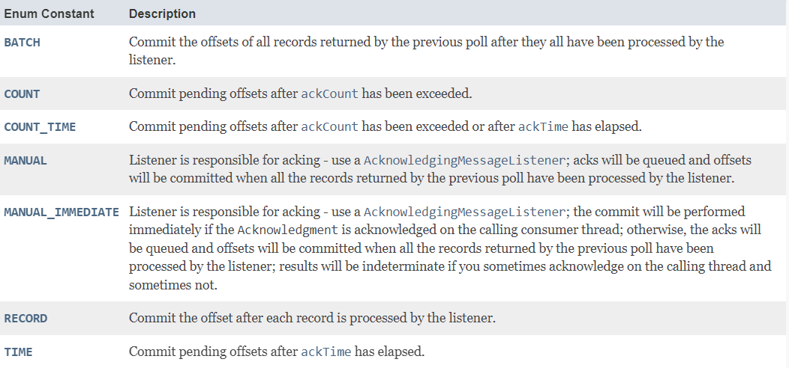
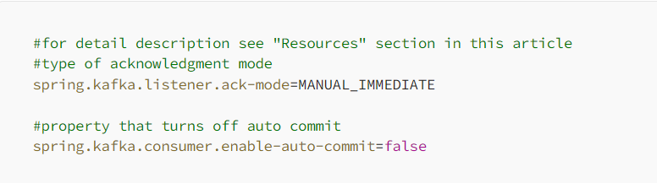
High-level consumer - Acknowledge
@KafkaListener(topics = “input-topic-3“, containerFactory=“myContainerFactory”)
void withAck(ConsumerRecord<?,?> record, Acknowledgement ack) {
log.info("Try to process message");
try {
//Some code
log.info("Processed value: " + record.value());
ack.acknowledge();
} catch (SocketTimeoutException e) {
log.error("Error while processing message. Try again later");
ack.nack(Duration.ofSeconds(5));
} catch (Exception e) {
log.error("Error while processing message: {} " + record.value());
ack.acknowledge();
}
}
Specify factory if more fine-grained control is needed
Allows for explicit ack. Spring supports a number of different ACT settings (batch, record, time etc)
Negative ack. Sleep & reseek partitions
Acknowledge

Slide 17
High-level consumer - Factory
@Bean
public ConcurrentKafkaListenerContainerFactory <?> myContainerFactory() {
Map<String, Object> props = new HashMap<>();
props.put(ConsumerConfig.BOOTSTRAP_SERVERS_CONFIG, bootstrapServers);
props.put(ConsumerConfig.KEY_DESERIALIZER_CLASS_CONFIG, StringDeserializer.class);
props.put(ConsumerConfig.VALUE_DESERIALIZER_CLASS_CONFIG, StringDeserializer.class);
props.put(ConsumerConfig.GROUP_ID_CONFIG, ”my-group");
var factory = new ConcurrentKafkaListenerContainerFactory<>();
factory.setConsumerFactory(new DefaultKafkaConsumerFactory(props));
factory.setBatchListener(true);
factory.setConcurrency(3);
return factory;
}
Place to specify group.id
Batch style needs to be specified in factory
Process partitions concurrently

Slide 18
Common Kafka consumer properties
spring.kafka.consumer.bootstrap-servers: Comma-separated list of Kafka broker addresses.
spring.kafka.consumer.group-id: The consumer group ID. It identifies a group of consumers that work together to consume Kafka messages.
spring.kafka.consumer.auto-offset-reset: Determines where a new consumer group should start consuming messages. Common values are "earliest" (from the beginning) or "latest" (from the latest).
spring.kafka.consumer.key-deserializer: Deserializer for the message keys.
spring.kafka.consumer.value-deserializer: Deserializer for the message values.
spring.kafka.consumer.max-poll-records: Maximum number of records to poll in each poll().
spring.kafka.consumer.fetch-min-size: Minimum amount of data the server should return for a fetch request.
spring.kafka.consumer.fetch-max-wait: Maximum amount of time the server should wait for more data to arrive.
spring.kafka.consumer.max-poll-interval-ms: Maximum time between polls.
spring.kafka.consumer.enable-auto-commit: If set to true, the consumer will automatically commit offsets.
spring.kafka.consumer.auto-commit-interval: The frequency at which the consumer's offsets are automatically committed.
spring.kafka.consumer.properties: Additional Kafka consumer properties. You can use this property to set any custom Kafka consumer configuration.
spring.kafka.listener.concurrency: The number of threads to use for message consumption.
spring.kafka.listener.poll-timeout: The timeout for each poll() operation.
spring.kafka.consumer.auto-commit-interval: The frequency at which offsets are committed when enable-auto-commit is set to true.

Slide 19
Exercise
Create spring consumer
Create a new topic with 2 partitions
Write a spring consumer that consumes from the above topic. Output the consumed messages
Open a new PowerShell and go to <project-folder>/docker
type ./kafka-producer-perf-test --topic demo-topic --num-records 10000 --record-size 2 --throughput 2
Verify that the messages are consumed in the java consumer
Change the program to do batch consumption and output the size of the batches.
Rerun the producer with this setting ./kafka-producer-perf-test --topic demo-topic --num-records 100000 --record-size 2 --throughput 10000
7.6

Slide 20
Kafka admin client
Kafka low-level style
Kafka spring style
Kafka admin client
Testing Kafka

Slide 21
Kafka admin
The Kafka client ships with an admin client that allows you to run administrative tasks against your Kafka cluster. Much the same way as CLI operations but just in Java instead.
Once initialized you can do CRUD operations on all Kafka entities like list, create, update and delete topics, consumer-groups etc. The Admin methods often return a KafkaFuture object to allow for async calls. To wait for the KafkaFuture to complete call the get method on the future:
Properties properties = new Properties();
properties.put("bootstrap.servers", "localhost:29092");
properties.put("client.id", "admin-client");
AdminClient client = AdminClient.create(properties);
ListTopicsResult topics = client.listTopics().names().get()

Slide 22
Kafka admin – topic operations
createTopics()
This method is used to create topics in a Kafka cluster. You can specify the topic name, the number of partitions, replication factor, and other topic configuration settings.
deleteTopics()
It allows you to delete topics in the Kafka cluster. You need to specify the names of the topics you want to delete.
listTopics()
This method retrieves a list of all the topics in the Kafka cluster.
describeTopics()
You can use this method to get detailed information about one or more topics. It provides information about the topic's partitions, replication factors, and configuration.

Slide 23
Exercise
Create new topic using admin client
Initialize the AdminClient using the example-code in the slides
Create NewTopic object using NewTopic(“topicName”,…) constructor
Use client.createTopics(topic) method to create the kafka topic
Verify that the topic has been created
7.7

Slide 24
Exercise
List all topics using admin client
Initialize the AdminClient using the example-code in the slides
Use client.listTopics() method to list all topics
Verify that the listed topics are correct
What other topic properties are available besides the name of the topic?
7.8

Slide 25
Overview
Kafka java style
Kafka spring style
Kafka admin client
Testing Kafka

Slide 26
Embedded Kafka
@SpringBootTest
@DirtiesContext
@EmbeddedKafka(partitions = 1, brokerProperties = { "listeners=PLAINTEXT://localhost:9092", "port=9092" }) public class EmbeddedKafkaTest {
@Autowired
private KafkaConsumer consumer;
@Autowired
private KafkaProducer producer;
@Test
public void sendAndTestIfMessageIsReceived() throws Exception {
String data = ”test-message";
producer.send(”test-topic", data);
boolean messageConsumed = consumer.getLatch().await(10, TimeUnit.SECONDS);
assertTrue(messageConsumed);
}
}
Ensure that our test bootstraps the Spring application context
Context is cleaned and reset between different tests
& Instantiate Embedded Kafka broker

Slide 27
TestContainers
@RunWith(SpringRunner.class)
@SpringBootTest()
@DirtiesContext
public class TestContainersTest {
@ClassRule
public static KafkaContainer kafka = new KafkaContainer(DockerImageName.parse("confluentinc/cp-kafka:latest"));
@Autowired
private KafkaConsumer consumer;
@Autowired
private KafkaProducer producer;
@Test
public void sendAndTestIfMessageIsReceived() throws Exception {
String data = ”test-message";
producer.send(”test-topic", data);
boolean messageConsumed = consumer.getLatch().await(10, TimeUnit.SECONDS);
assertTrue(messageConsumed);
}
}
Run Kafka in a container

Slide 28
Consumer wrapper
@Component
public class KafkaConsumer {
private static final Logger LOGGER = LoggerFactory.getLogger(KafkaConsumer.class);
private CountDownLatch latch = new CountDownLatch(1);
@KafkaListener(topics = "${test.topic}")
public void receive(ConsumerRecord<?, ?> consumerRecord) {
LOGGER.info("received payload='{}'", consumerRecord.toString());
latch.countDown();
}
public void getLatch() {
return latch;
}
public void resetLatch() {
latch = new CountDownLatch(1);
}
}

